Slide 1

Autralilia Weather
Tyler Anderson
DSC 630 Predictive analytics
Notes:
Hello My name is Tyler Anderson and this is my project for Australia Weather! This is my final project for DSC 630 Predictive Analytics

Slide 2
Important Question
Will it rain in Australia or not?
In this project we try to answer the question that whether or not it will rain the next day in Australia. This project implements Logistic Regression and Scikit-Learn libraries. To answer this question, I built a binary classifier to predict whether or not it will rain the next day in Australia.
Notes:
For my project I an trying to answer the question Will it rain in Australia or not?

Slide 3
Base libraries I'm using
Numpy
Pandas
Matplotlib
Seaborn
Notes:
There are many more libraries like sklearn I will be using but these are the basic libraries that I will use in the project.

Slide 4
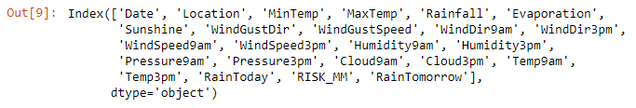
Exploring the data
I am using weather data, weatherAUS.csv, retrieved from Kaggle, as my dataset for this project and importing it using pandas
df.shape shows 42193 instances and 24 variables in the data set.
To view the column names I do df.columns and it gives me:
Notes:
I used a dataset that contains 10 years of daily weather observations from 2008-2017 from the Australian weather stations. Although the dataset is very complete there is some cleaning steps that need to be done prior to training the dataset and fitting it to our binary classification model.

Slide 5
The dataset came with a description to drop the variable RISK_MM if you are using it to predict rain the next day. I did this by using df.drop
df.drop(['RISK_MM'], axis=1, inplace=True)
After dropping we can use df.info() to confirm the variable is dropped. This also shows a mix of categorical and numerical variables. Ill have to convert some of these down the road to datatype float64 or numerical variables
Notes:
The dataset was retrieved from Kaggle and the description for the dataset suggested to remove RISK_MM variable.
RISKMM is the amount of rainfall in millimeters for the next day. It includes all forms of precipitation that reach the ground, such as rain, drizzle, hail and snow. And it was the column that was used to actually determine whether or not it rained to create the binary target. For example, if RISKMM was greater than 0, then the RainTomorrow target variable is equal to Yes.
Since it contains information about the future, and since it contains information directly about the target variable, including it would leak the future information to your model. Using it as a predictor to build a model and then testing on this dataset would give the false appearance of a high accuracy.
It is included in the dataset so that if you wanted to create your own binary target and decide that a really small amount of rain like 0.1 mm shouldn't be counted as a rainstorm, you could try predicting only more significant amounts of rain.
It's also included in the dataset so that, if you wanted to, you could use the dataset to build a regression machine learning model -- instead of classification. In other words, you can use RISK_MM as your target and drop RainTomorrow if you want to treat this as a regression problem instead of a classification problem. In this case we will be dropping it since we are using RainTomorrow as out target variable

Slide 6
Univariate Analysis
Our target variable here is “RainTomorrow”
Using df['RainTomorrow'].isnull().sum() we can see there are 0 missing values in the dataset
Using df['RainTomorrow'].nunique() we can see there are only 2 unique values for “RainTomorrow”
Using df['RainTomorrow'].unique() we can see that both unique values are binary ‘No’ or ‘Yes’
Notes:
Here we are doing univariate analysis
Like we previously stated RainTomorrow is our target variable and we want to look at this variable and determine if it is in good shape for a target variable.
Rain tomorrow is a variable that tells the future we can use this to train our model on to determine our accuracy. Raintomorrow gives us a baseline of what variables may be contributing to a yes or no answer in if it will rain the next day.

Slide 7
Exploring further shows that out of the total number of ‘RainTomorrow’ values, No appears 77.58% times and Yes appears 22.42% times.
So it did not rain more than it did rain. This will help us determine some factors about what we can use to predict if it will rain or not.

Slide 8
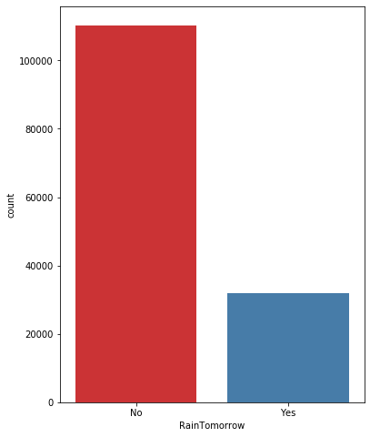
Univariate Analysis cont.
This plot confirms that ‘No’ has more entries than ‘Yes’

Slide 9
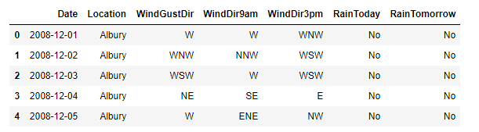
Bivariate Analysis
The dataset has both categorical and numerical variables that has caused me some headaches in the past if I don’t try to address this not to make my job easier down the road.
There are a total of 7 categorical variables listed.
Showing a head of the categorical variables to view them.
Notes:
For out Bivariate Analysis I segregate the dataset into categorical and numerical variables. There is a mixture of categorical and numerical variables in the dataset. Categorical variables have data type object. Numerical variables have data type float64. I want to first explore the Categorical variables, those variables are 'Date', 'Location', 'WindGustDir', 'WindDir9am', 'WindDir3pm', 'RainToday', and 'RainTomorrow'. Looking at this I notice date is considered a categorical variable that I will have to break up into smaller numerical variables later.

Slide 10
Exploring the Categorical Variables
When exploring the categorical variables we can see that there are some missing values:
WindGustDir 9330
WindDir9am 10013
WindDir3pm 3778
RainToday 1406
Notes:
Checking for missing values we can see that there are only 4 categorical variables in the dataset which contains missing values. These are WindGustDir, WindDir9am, WindDir3pm and RainToday.

Slide 11
When exploring the labels within these categorical variables we can see that the ‘date’ variable has a lot of labels 3,436 labels to be exact.
The ‘Date’ variable needs to be addressed since it has high cardinality or lots of variables.
High cardinality may pose some serious problems in the machine learning model.
Notes:
Next I look up the labels for each variable to check for cardinality, the number of labels within a categorical variable. A high number of labels within a variable is known as high cardinality. High cardinality may pose some serious problems in the machine learning model. When checking for categorical variables I can see that date contains 3,436 labels while the next highest is location which has 49, meaning the Date variable has high cardinality. We can see that the Date variable needs to be preprocessed, all the other variables contain relatively smaller number of variables.

Slide 12

Using datetime on Date variable
Using this string I can parse the dates from strings into a datetime format.
df['Date'] = pd.to_datetime(df['Date’])
I can now extract year, month and day from the date variable
Now that I have separated out year, month and day I can delete the ‘date’ variable. There should now be 6 categorical variables now
Notes:
For the date variable we need to break it up using some feature engineering. I can parse the dates currently coded as strings into a datetime format
I can then continue to extract the year, month and day from the Date variable and create new columns created from the date variable. I can then remove the date variable from the dataset
Previewing the data again I can see its been removed.

Slide 13
Explore Numerical Varialbes
Exploring shows there are 19 numerical variables
All of the numerical variables are of continuous type
Notes:
I can now move on to exploring the numerical variables. There is a total of 19 numerical variables, MinTemp, MaxTemp, Rainfall, Evaporation, Sunshine, WindGustSpeed, WindSpeed9am, WindSpeed3pm, Humidity9am, Humidity3pm, Pressure9am, Pressure3pm, Cloud9am, Cloud3pm, Temp9am and Temp3pm. All the numerical variables are of continuous type. The numerical variables will have to be checked for missing values and outliers.

Slide 14
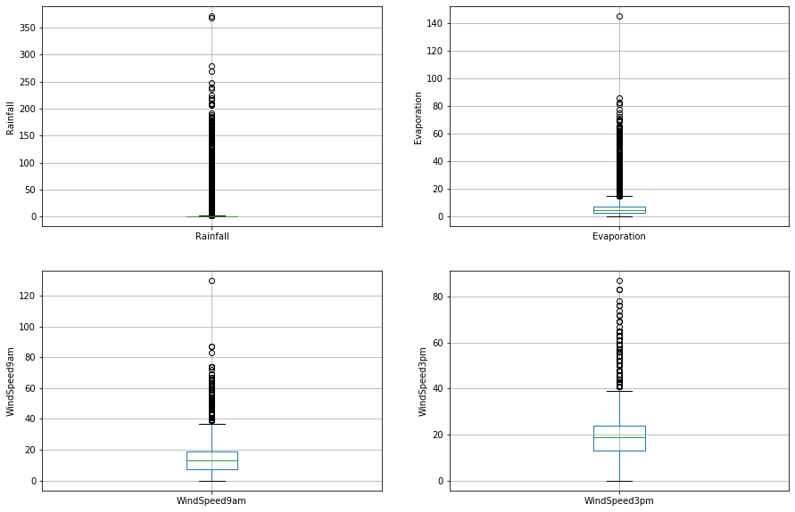
Outliers within numerical variables
We can see that the Rainfall, Evaporation, WindSpeed9am and WindSpeed3pm columns may contain outliers when using describe to view details.
Plotting these as boxplots shows the outliers.
Notes:
The numerical variables will have to be checked for missing values and outliers.
Veiwing summary statistics we can see that the Rainfall, Evaporation, WindSpeed9am and WindSpeed3pm columns may contain outliers. To visually see these outliers, I can plot boxplots to visualize the outliers.
We can clearly see it here in the plots

Slide 15
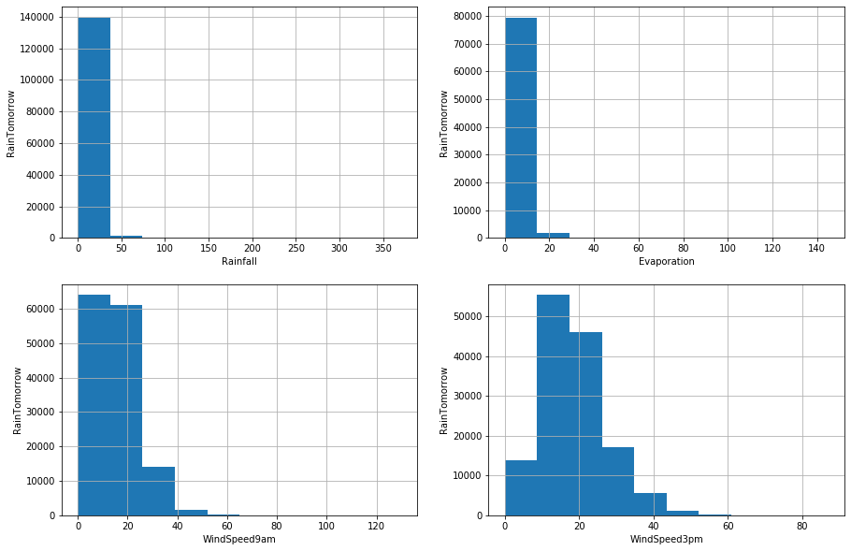
Checking Outliers
Plotting them as box plots checks the distributions to see if they are normal of skewed.
We can see they all of them are skewed.
Notes:
I can now plot histograms to check distributions to find out if they are normal or skewed. Plotting them as box plots checks the distributions to see if they are normal of skewed. My results indicate that they are skewed to the right.

Slide 16
Using interquantile range (IQR)
The interquartile range (IQR) is the difference between the first quartile and third quartile.
Since the variables are skewed IQR is my best choice to find outliers
I got my Idea on how to do this via Kaggle and got help there.
Rainfall outliers are values < -2.4000000000000004 or > 3.2
Evaporation outliers are values < -11.800000000000002 or > 21.800000000000004
WindSpeed9am outliers are values < -29.0 or > 55.0
WindSpeed3pm outliers are values < -20.0 or > 57.0
Notes:
Because they are skewed, I can find the IQR or Interquantile range. The interquartile range (IQR) is the difference between the first quartile and third quartile. Since the variables are skewed IQR is my best choice to find outliers. Using help from Stack Exchange and Kaggle my results for IQR are:

Slide 17
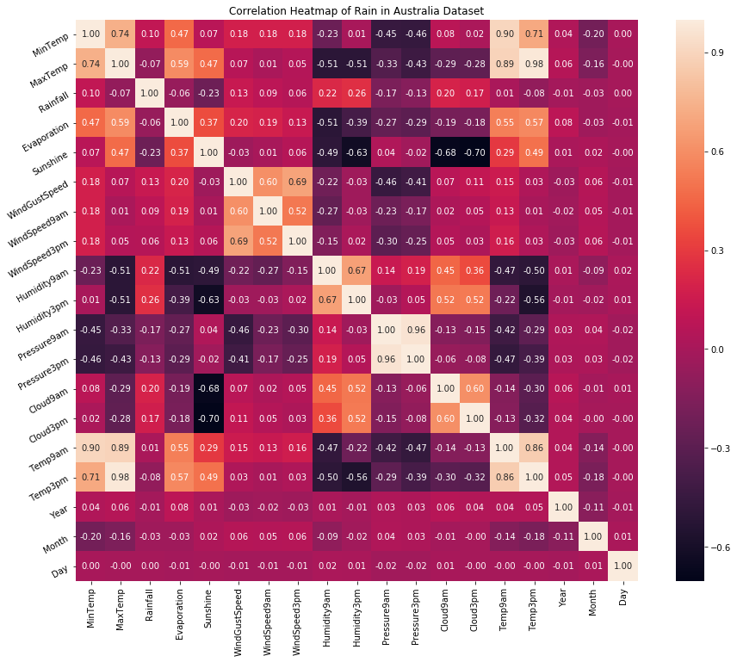
Multivariate Analysis
Here we are trying to discover relationships between the variables in the dataset.
Drawing a heatmap will give me correlations between the variables.
We can see that 'MinTemp', 'MaxTemp', 'Temp9am', 'Temp3pm', 'WindGustSpeed', 'WindSpeed3pm', 'Pressure9am’ and 'Pressure3pm are all highly correlated with one another.
Notes:
I can now move on to Multivariate Analysis. In this step I want to discover patterns and relationships between variables in the dataset. Drawing a heatmap will give me correlations between the variables
We can see that 'MinTemp', 'MaxTemp', 'Temp9am', 'Temp3pm', 'WindGustSpeed', 'WindSpeed3pm', 'Pressure9am’ and 'Pressure3pm are all highly correlated with one another.

Slide 18
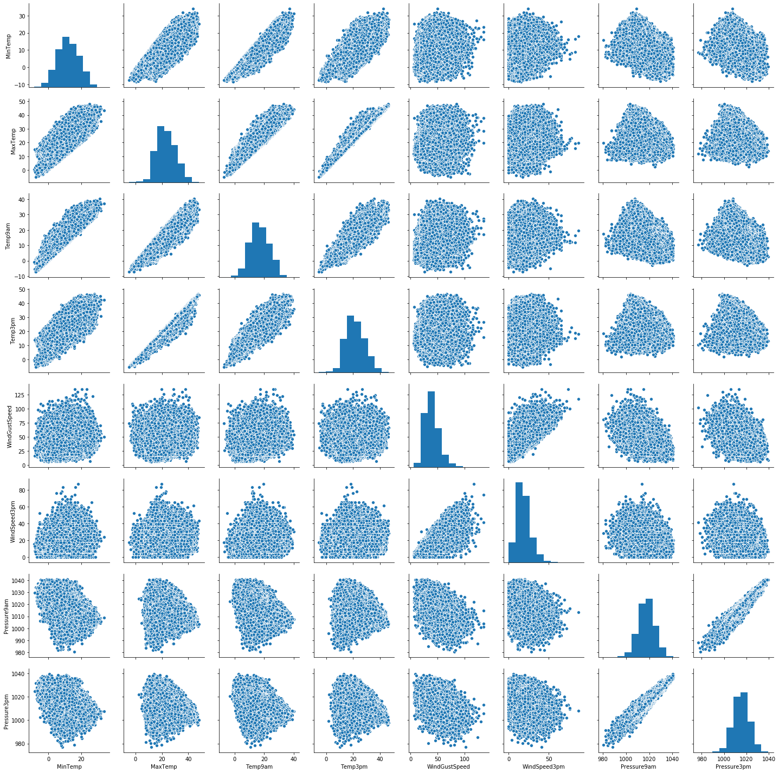
Using a pair plot
I can now use a pair plot on the variables
Defining the variables that are highly correlated allows me to execute the pair plot.
Notes:
Using the highly correlated variables I can extract them and draw a pair plot to look at the direct relationship between them.

Slide 19
I have defined a variable num_var which consists of MinTemp, MaxTemp, Temp9am, Temp3pm, WindGustSpeed, WindSpeed3pm, Pressure9am and Pressure3pm variables.
The pair plot shows the relationship between them.
Notes:
Read slide Now I can declare a feature vector for the target variable RainTomorrow and split the data into separate training and testing sets using the sklearn package. My train and test variables will be listed as X_train and X_test

Slide 20
Feature Engineering
Feature Engineering is the process of transforming raw data into useful features that help us to understand our model better and increase its predictive power. I will carry out feature engineering on different types of variables.
I declared a feature vector and my target variable which is the RainTomorrow variable.
Put the data into training and testing sets
Notes:
Read slide I can now do some more feature engineering particularly with transforming the data into something more useful for the categorical and numerical variables.

Slide 21
Fixing all the missing values
I am not sure if there is a pattern of the missing data or things are left out purposefully and it may be that the missing values are completely random and not really be indicative of something else. There are multiple ways to remove the missing data but I can impute them since there are outliers in the data. Ill only use imputation on the training set to try to avoid overfitting. I can do this for both numerical and categorical values.
Notes:
I first need to look at both separately to see their missing values and to start to remove them. I am not sure if there is a pattern of the missing data or things are left out purposefully and it may be that the missing values are completely random and not really be indicative of something else. There are multiple ways to remove the missing data, but I can impute them since there are outliers in the data. Ill use imputation on the training and test sets to try to avoid overfitting. I can do this for both numerical and categorical values.

Slide 22
Imputation of numerical variables
Impute missing values in X_train and X_test with respective column median in X_train
Use numerical sum to look at missing values. We can see that there are now 0 missing values.
X_train[numerical].isnull().sum()
X_test[numerical].isnull().sum()
Notes:
I can start with imputing missing values in X_train and X_test with respective column median in X_train. After removing the missing values I can check for missing values again and it shows 0 missing values for all numerical variables.

Slide 23

Imputation of categorical variables
Here we continue to impute missing values in X_train and X_test with respective column median in X_train.
I can continue to check for missing values with:
X_train[numerical].isnull().sum()
X_test[numerical].isnull().sum()
We can see there are no more missing values
Notes:
I can do the same steps with the categorical variables and test both the train and test sets for missing values after I impute all categorical and numerical variables for missing values.

Slide 24
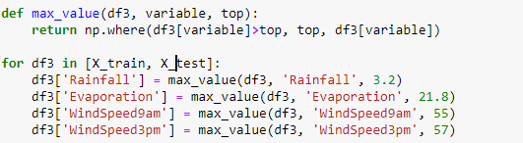
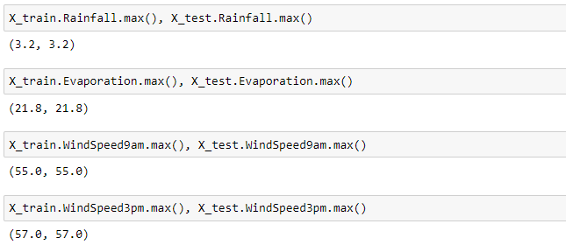
Engineering outliers
Rainfall, Evaporation, WindSpeed9am and WindSpeed3pm columns contain outliers. I want to cap these so that they exclude the outliers all together.
We can see the caps for all 4 of these variables on our train and test sets
Notes:
I can now move on to the outliers in the train and test sets. We have seen that the Rainfall, Evaporation, WindSpeed9am and WindSpeed3pm columns contain outliers. I can use top-coding approach to cap maximum values and remove outliers from the above variables. As an example of the process I can use this block of code to execute the top-coding approach.
This allows me to look at each variable and look at the maximum value for each
This also caps the maximum values for all the numerical values to get rid of the outliers

Slide 25
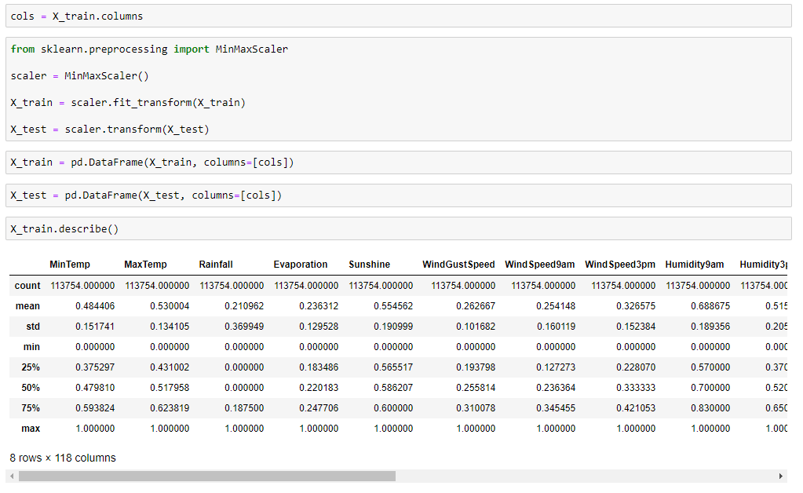
Feature Scaling
Map all the feature variables into the same scale.
Use minmaxscaler from sklearn.
This gets the X_train dataset ready to be fed into the Logistic Regression classifier
Notes:
I can map all the feature variables by describing the X_train data to view the dataframe. I can create a variable called ‘cols’ by passing through the columns from X_train through it. Using sklearn MinMaxScaler I can get the X_train dataset ready to be fed into the logistic Regression classifier.

Slide 26
Model training
I will train the model via Logistic Regression
Instantiate the model
logreg = LogisticRegression(solver='liblinear', random_state=0)
Fit the model
logreg.fit(X_train, y_train)
Notes:
I train the logistic regression model on the training set using sklearn LogisticRegression and instantiate the model logreg = LogisticRegression(solver='liblinear', random_state=0) and fit it to the model logreg.fit(X_train, y_train). We can now predict our results.

Slide 27

Starting the predictions
Testing to see if the results are working.
We can see that the model is working to predict weather outcomes
Notes:
Read slide

Slide 28
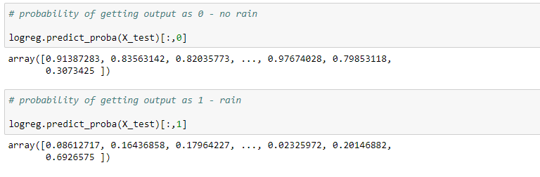
Using predict_proba for probabilities
Predict_proba method gives the probabilities for the target variable(0 and 1) in this case, in array for 0 is for probability of no rain and 1 is for probability of rain.
Notes:
To predict the results, I use the predict_proba method that can givce me the probabilities for the target variable (0 and 1) in an array form. In this case 0 is for probability of no rain and 1 is for probability of rain. For my probability of getting output 0 for no rain I use logreg.predict_proba(X_test)[:,0] for probability of getting output 1 for rain I use logreg.predict_proba(X_test)[:,1].

Slide 29
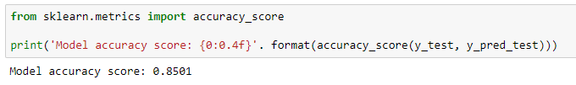
Checking accuracy using accuracy_score
Checking accuracy by using sklearn accuracy score package.
We get an initial accuracy of 85%
Notes:
To check my accuracy, I start with my test set. I can use sklearn metrics accuracy_score package and run this script (On the slide)
I get an accuracy score of 0.8501. Here, y_test are the true class labels and y_pred_test are the predicted class labels in the test-set

Slide 30
Check training accuracy
We can see that the training accuracy is 84%
Notes:
I can now do the same thing for my train set and get an accuracy score of 0.8476.

Slide 31
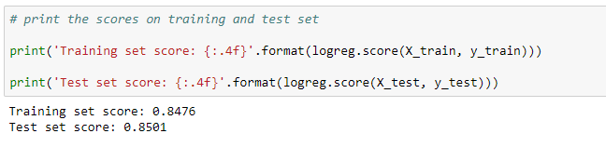
Check for overfitting
Our training set score was 84%
Out test set score was 85%
Based on these two accuracies there is no overfitting which is very good!
Notes:
The training-set accuracy score is 0.8476 while the test-set accuracy to be 0.8501. These two values are quite comparable. So, there is no question of overfitting.

Slide 32
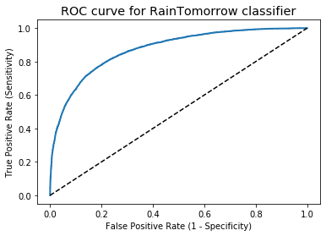
ROC Curve
Using a ROC curve we can determine if our model does a good job of predicting rain tomorrow in Australia.
We can see the ROC curve is close to 1 meaning it does a very good job in predicting rain the next day in Australia
Notes:
Lastly, we can determine how well out model does its prediction by plotting a ROC curve. This curve indicates the model does a good job of predicting how well our model predicts the rain tomorrow in Australia

Slide 33
Conclusion
The logistic regression model accuracy score is 0.8501. So, the model does a very good job in predicting whether or not it will rain tomorrow in Australia.
Small number of observations predict that there will be rain tomorrow. Majority of observations predict that there will be no rain tomorrow.
The model shows no signs of overfitting.
Increasing the threshold level results in increased accuracy.
ROC curve of our model approaches towards 1. So, we can conclude that our classifier does a good job in predicting whether it will rain tomorrow or not.
Notes:
Overall our logistic regression model accuracy score was 0.85. So, in short, the model does a pretty good job of predicting whether it will rain or not in Australia. Of all the observations the majority will predict that there will be no rain tomorrow. The model also shows no signs of overfitting. My ROC curve was well bowed or approached 1 so it did a very good job in predicting if it will rain in Australia tomorrow or not. A couple of things have occurred to me during this project and its conclusion. I wondered how the accuracy change would if it used the data from multiple days before to predict rain. So, instead of the previous day predicting the rain the next day what about the previous 2 or 3 days? Would the accuracy change any? Would the accuracy be better or worse? With the current accuracy we got for the project I would say it can definitely be used with new data to try to determine rain in Australia in a live scenario.

